Slide 1

GAYATRI VIDYA PARISHAD COLLEGE OF ENGINEERING FOR WOMEN MADHURAWADA, VISAKHAPATNAM
2020-2024 ADMITTED BATCH
Department of Electronics & Communication Engineering
IMPLEMENTATION OF 32-BIT COMBINED INTEGER AND FLOATING POINT MULTIPLIER USING REVERSIBLE LOGIC
Project Domain : Digital VLSI Design
Guide Name:
Ms. B. Divya Sathi ( Asst. Professor)
(Department of ECE)
Batch No : 10 Section : ECE-1
20JG1A0419 | 20JG1A0440 | 20JG1A0450 | 20JG1A0401
CH.Bhargavi | K. Deekshitha | K.Gurutejitha | A.Sai sravani

Slide 2
CONTENTS :
Abstract
Flow Chart
Peres Gate, Feynman Gate waveforms
Block Diagram of Floating Point Multiplier and Combined Integer and Floating Point Multiplier
Calculations
Half Adder using Peres Gate
Multiplier Outputs using Reversible Logic Gates(RLG)
2 bit Multiplier
4 bit Multiplier
8 bit Multiplier
16 bit Multiplier
32 bit Multiplier
Floating point Multiplier
32bit Combined integer and Floating Point Multiplier using Reversible Logic
Delay Comparison Table
Applications
Conclusion & References

Slide 3
ABSTRACT :
The delay required for operations in electronic products needs to be minimized to ensure reliable performance. Design of multipliers with lesser delay and increased throughput will lead the systems to operate with high speed. The design of traditional digital circuits relies on fundamental computational techniques that entail gate delays during logic operations. This design mitigates such delay in computations by minimizing them. By exploiting the inherent reversibility of the logic gates, the design aims to mitigate energy dissipation and enhance computational efficiency. Leveraging reversible logic not only facilitates the multiplication process but also enables the retrieval of original operands from the product, thus ensuring information preservation.
Floating point multiplication is a common operation in advance Digital Signal Processing (DSP) application. This design proposes a 32-bit Reversible Floating Point Multiplier using reversible gates i.e; Feynman, Peres Gates. Throughout the design of this multiplier circuit, a crucial aspect to consider is its compatibility with the environment and intended application. Furthermore, the circuit's feasibility is heavily influenced by design variation, which can cause notable deviations in the output of digital circuits that are measurable and predictable. In this design proposed multiplier performs multiplications with increased throughput by using minimal power. Implementation of the multiplier circuit is conducted using Xilinx technology, emphasizing practical applicability and seamless integration into existing digital systems. By prioritizing efficiency, throughput, and delay, this project aims to contribute to the advancement of digital signal processing capabilities in various domains. Ultimately, the development of a versatile and high speed multiplier unit capable of handling both integer and floating-point arithmetic operations concurrently will significantly enhance the efficiency and scalability of VLSI systems, catering to a wide range of computational requirements across various applications domains.

Slide 4
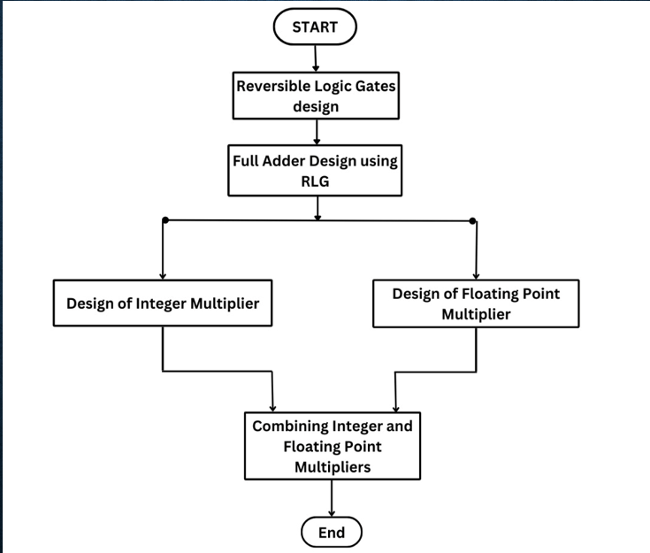
FLOW CHART :

Slide 5
Reversible Logic:
Reversible Logic Gate is an n-input n-output logic device with one-to-one mapping. It helps to identify the output from the input and can specifically recover any input from the output. It is a type of computing logic where every operation is invertible, meaning that both the input and output states can be uniquely determined. Reversible logic has various applications in various fields like in Nano-technology, Quantum computing, Low power CMOS, Optical computing etc.
Types of Reversible Logic Gates:
Peres Gate
Feynman Gate
Fredkin Gate
Transparency Symmetric Gate
Toffoli Gate
Advantages:
Flexibility: It refers to the universality of a Reversible logic gate in realizing more functions.
Gate Level: This refers to the number of levels in the circuit which are required to realize the given logic functions.
Efficiency: It refers to that we can implement complex circuits by using Reversible Logic.
Batch No. 10
5

Slide 6
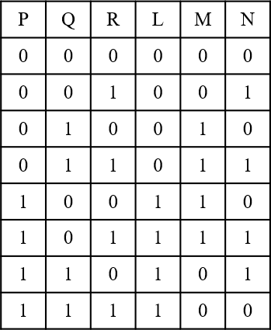
Peres Gate :
The Peres reversible gate, is a quantum logic gate used in quantum computing. It performs reversible operations on quantum bits, which means it can be run forwards or backwards with no information loss . It has 3 inputs and 3 outputs and can be verified that the input pattern corresponding to a particular output pattern can be uniquely determined.
Quantum Logic: A Quantum Logic is a basic quantum Circuit operating on a small number of Qubits.
Qubits: It can be in a State that is a Linear combination of both 0 and 1 simultaneously . This Property allows to perform calculations faster.
P
L=P
Q
Peres Gate
M=P XOR Q
R
N=(P AND Q) XOR R
Fig 1: Peres gate and it’s Truth table

Slide 7
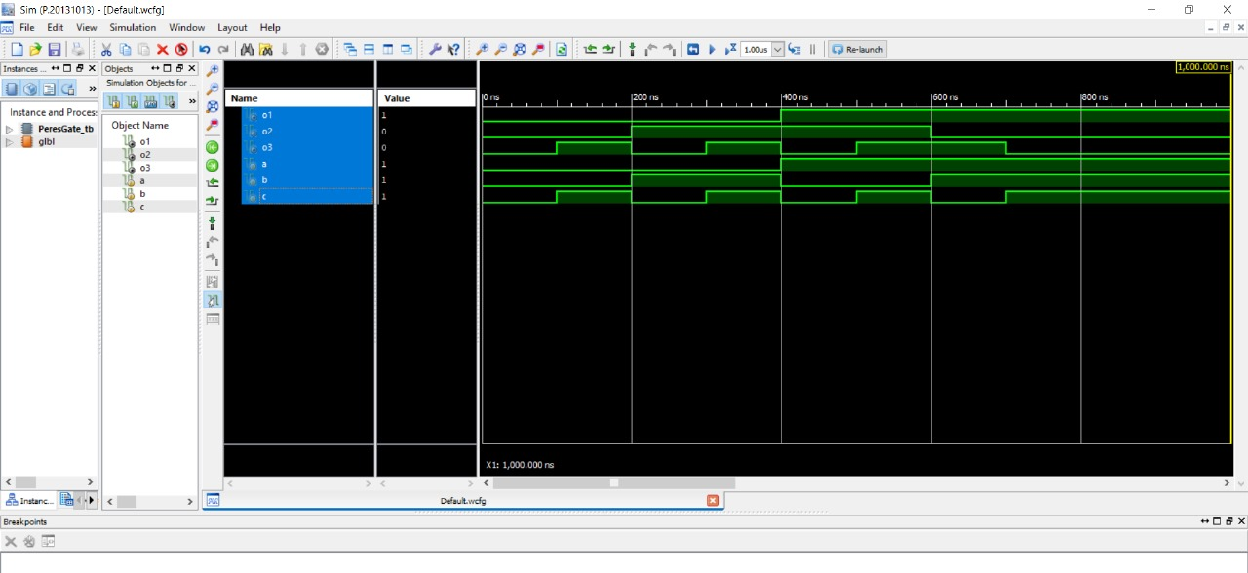
Peres Gate waveform
Batch No. 10 7

Slide 8
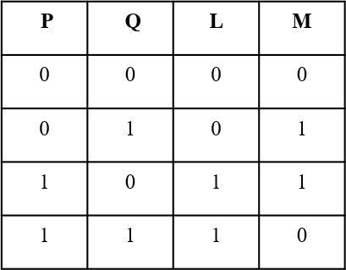
Feynman Gate:
Feynman gate is a 2*2 one through reversible gate as shown in figure 2. The input vector is II(A, B) and the output vector is O(P, Q). The outputs are defined by P=A, Q=A ⊕B. Feynman Gate (FG) can be used as a copying gate . Since a fan-out is not allowed in reversible logic, this gate is useful for duplication of the required outputs.
A
P=A
Feynman Gate
B
Q=A XOR B
Fig 2:Feynman gate and it’s Truth table

Slide 9
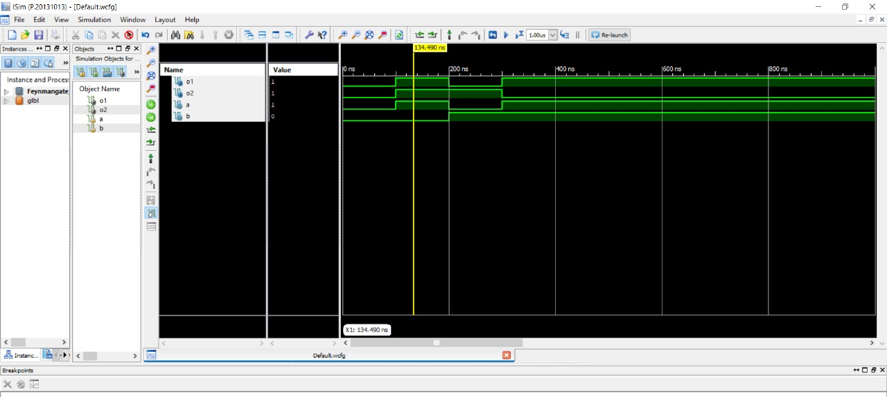
Feynman Gate Waveform :
Batch No. 10 9

Slide 10
Input 1[31:0]
32x32 bit Multiplier
[63:0] output
Input 2[31:0]
Block Diagram of Integer Multiplier

Slide 11
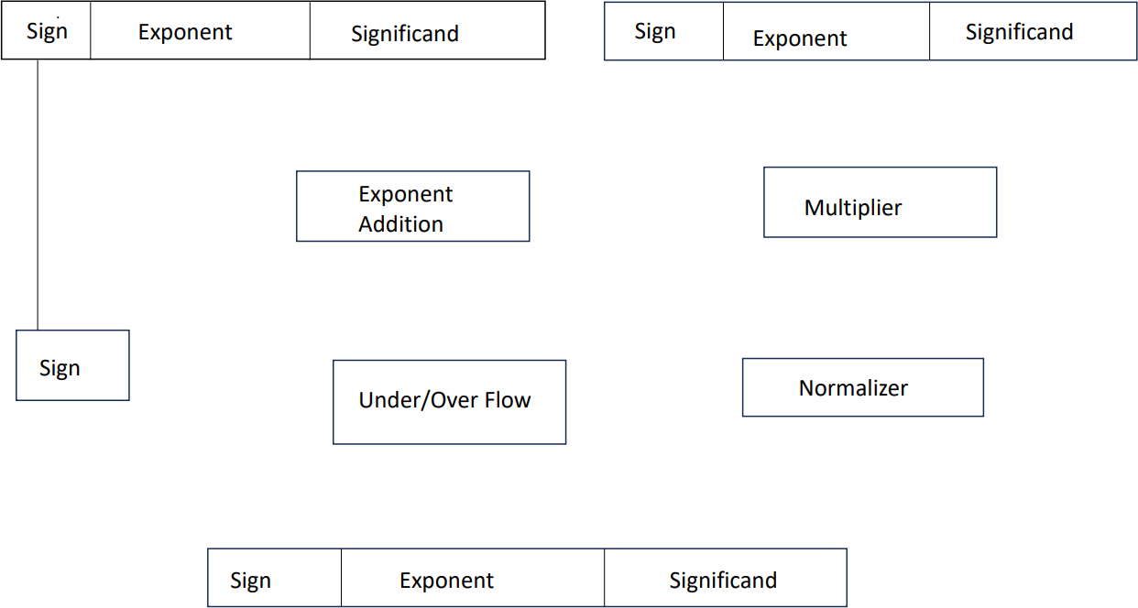
Input 1 Input 2
31 30 23 22 0
31 30 23 22 0
0/1
Block Diagram of 32 bit Floating point multiplier
10

Slide 12
Combined Integer and Floating Point Multiplier:
^{Input1(32bit)} Input2(32bit)
Combined integer & Floating point Multiplier
If
both inputs are integers
Any 1 input is floating number
Integer output(64bit)
Floating point output(32bit)

Slide 13
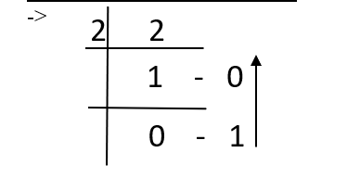
IEEE 754 FORMAT:
The IEEE 754 standard defines formats for representing floating-point numbers, as well as rules for performing arithmetic operations on them. It specifies formats for single precision (32-bit) and double precision (64-bit) floating-point numbers, along with encoding schemes for special values such as positive and negative infinity, zero, and NaN (Not a Number).
Floating-point numbers represented according to IEEE 754 consist of three components: a sign bit, an exponent, and a significand (also known as a mantissa). The sign bit determines whether the number is positive or negative, the exponent specifies the magnitude of the number, and the significand holds the precision or accuracy of the number.
Conversion of Decimal to IEEE 754 32-bit floating point notation :
Example: 2.5
Convert 2 into binary form
Batch No. 10 12

Slide 14
2=10
convert 0.5 into Binary form
0.5x2 | 1.0 | 1
0.5=1
Step-1: Representation of 2.5 in binary form
10.1
Step-2:Need to shift the decimal point to the left till it reaches the 2nd bit.
1.01x2¹ (scientific notation)
Step-3: For positive number representation of sign bit is 0 and for negative number sign bit is 1.
Taken number is a positive number ,so sign bit is 0.
In the IEEE 754 notation Exponent has to cover both positive and negative numbers so bias added(127).
For taken number bias is 127+1=128 so, binary representation of 128 is the exponent of this number.
Batch No. 10 13

Slide 15
1-sign bit 8 exponent bits 23 fraction bits
0 10000000 01000000000000000000000000000000
32 bit Floating point number representation of 2.5 is 01000000001000000000000000000000000000000
Calculation of Floating point Multiplication:
Decimal IEEE format:
Input1=+2.5 → +1.25x2¹
Input2=+2.5 → +1.25x2¹
Sign = (+) + (+) =+
Exponent=2¹ +2¹ =2²
Mantissa=1.25x1.25=1.5625
Output=+1.5625x2² =+6.25
Binary Representation of output:01000000110010000000000000000000
Batch No. 10 14

Slide 16
Calculation:
Decimal IEEE format:
Input1=+110.692764 +1.7295744 x2⁶
Input2=+166.45981 +1.3004673 x2⁷
Sign = (+) + (+) =+
Exponent=2⁶ +2⁷ =2¹³
Mantissa=1.7295744x1.3004673 =2.24925495
For 32 bit floating point multiplication exponent takes 8 bits if exponent exceeds 2⁸ ,Normalization is required,it can be done by 2.24925495 divided and multiplied by 2 equals to 1.1246275x2
Output=+1.1246275x2¹⁴ =+18425.896
Binary Representation of output:01000110100011111111001111001011
Batch No. 10 15

Slide 17
Conversion of binary to decimal:
Output:
0 | 10000001 | 10010000000000000000000
Sign exponent fraction
According to sign bit it is a positive number: +1
Exponent: 10000001 =(129)₁₀
Remove bias from the exponent (127) = 129-127=2
Convert fraction bits back to base 10
10010000000000000000000= 1x2⁻¹+0x2⁻² +0x2⁻³+1x2⁻⁴
=1/2 +1/16 =0.5625
For the single precision floating number add 1 to fraction :1+0.5625=1.5625
Combine all parts:1x(1.5625)x2129-127 =+6.25
Batch No. 10 16

Slide 18
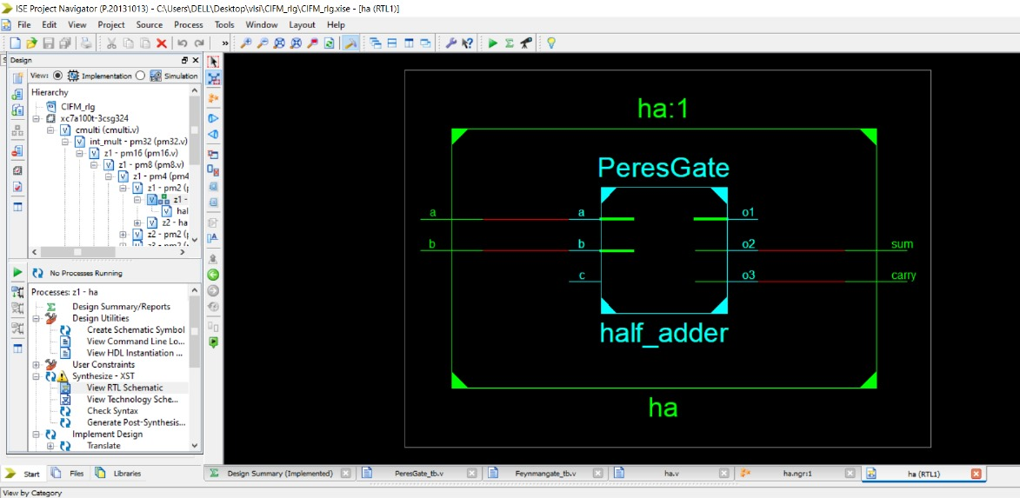
Half Adder using Peres Gate:
Batch No. 10 17

Slide 19
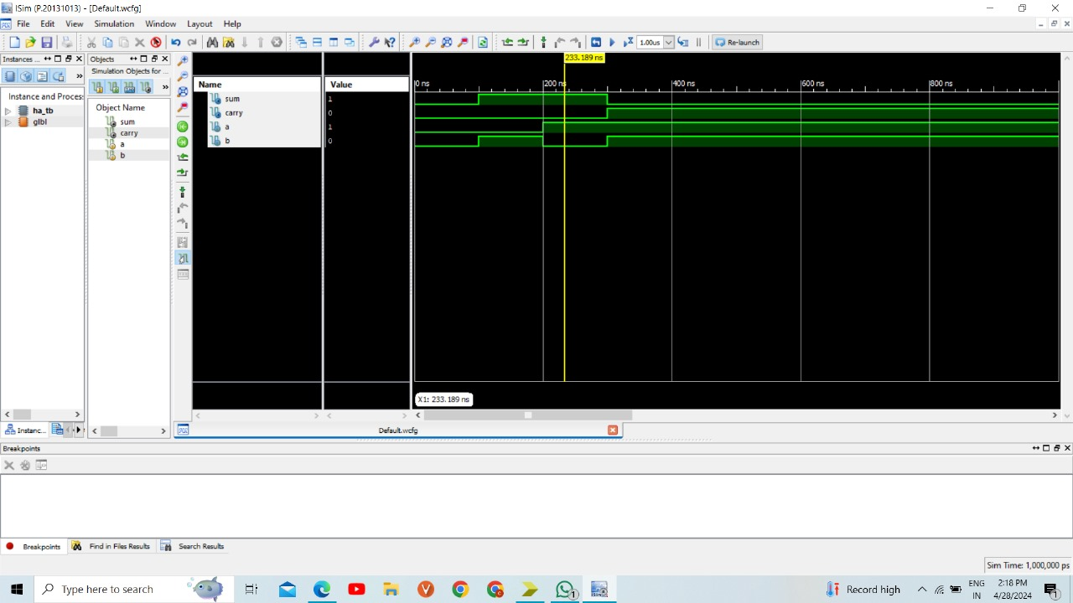
Waveform of Half Adder:
Batch No. 10 18

Slide 20
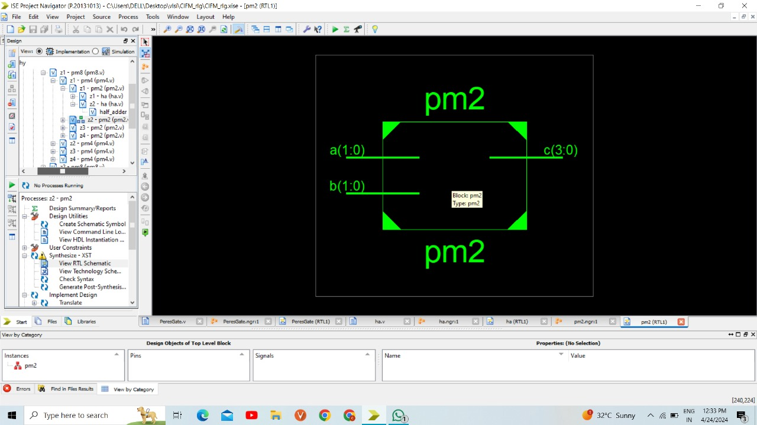
2 bit Multiplier using Reversible logic:
Batch No. 10 19

Slide 21
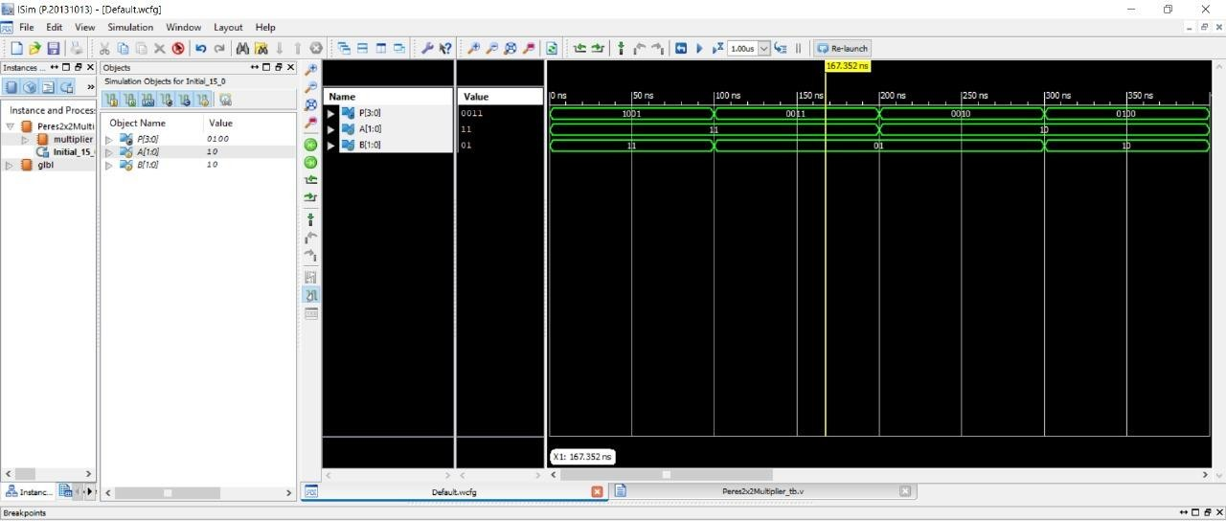
Waveform of 2bit Multiplier using Reversible logic:
Batch No. 10 20

Slide 22
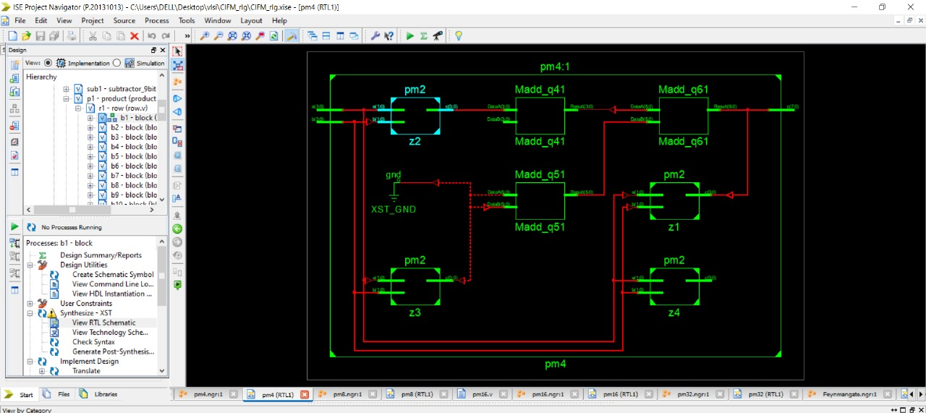
4-bit Multiplier using 2-bit Multiplier :
Batch No. 10 21

Slide 23
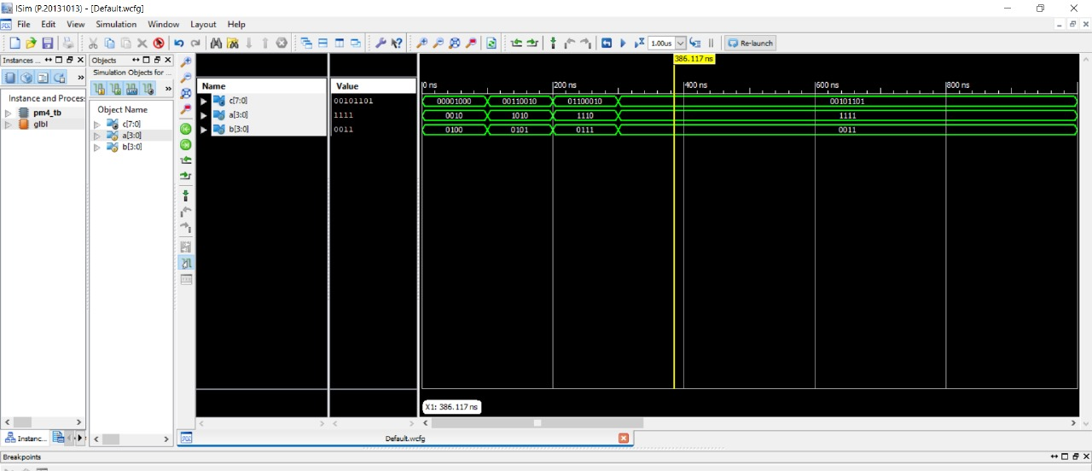
Wave Form of 4-bit Multiplier :
Batch No. 10 22

Slide 24
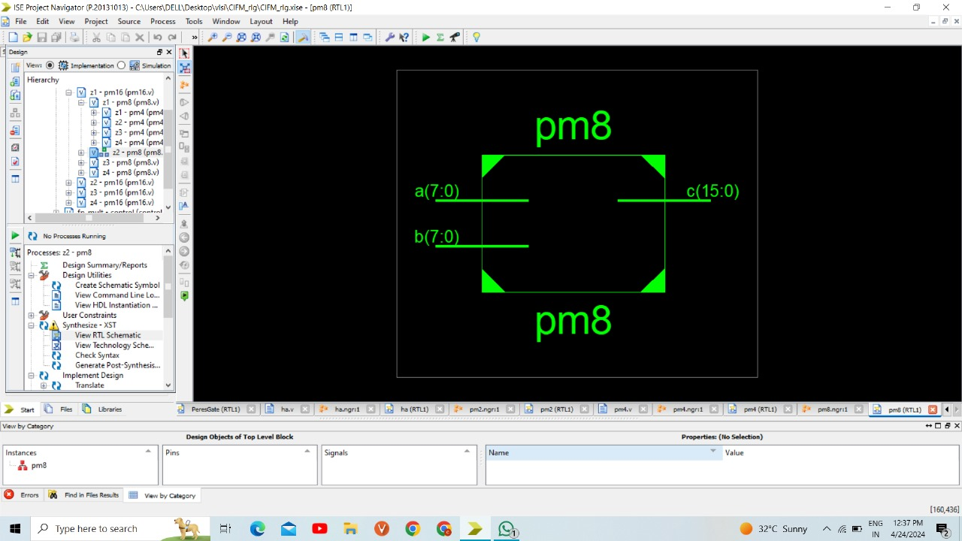
8 bit Multiplier using 4-bit Multiplier :
Batch No. 10 23

Slide 25
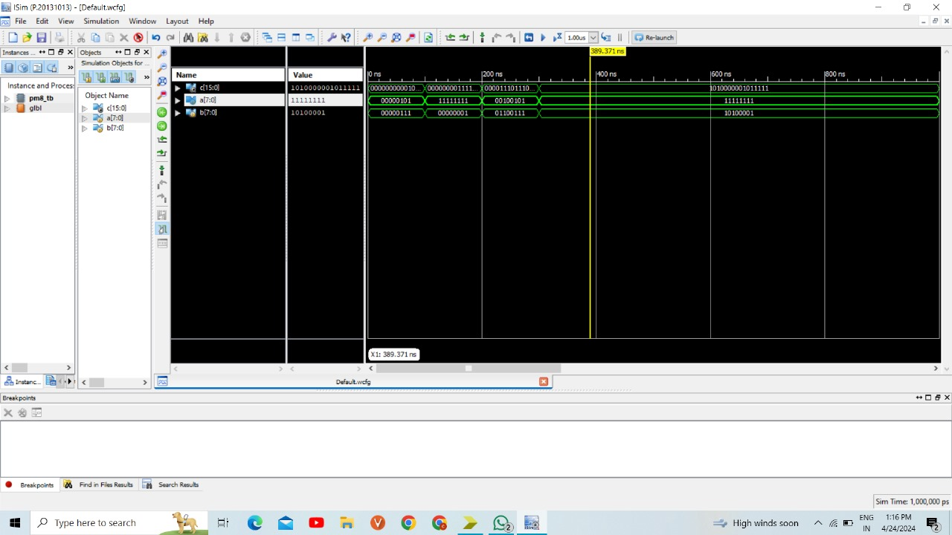
Wave Form of 8bit Multiplier :
Batch No. 10 24

Slide 26
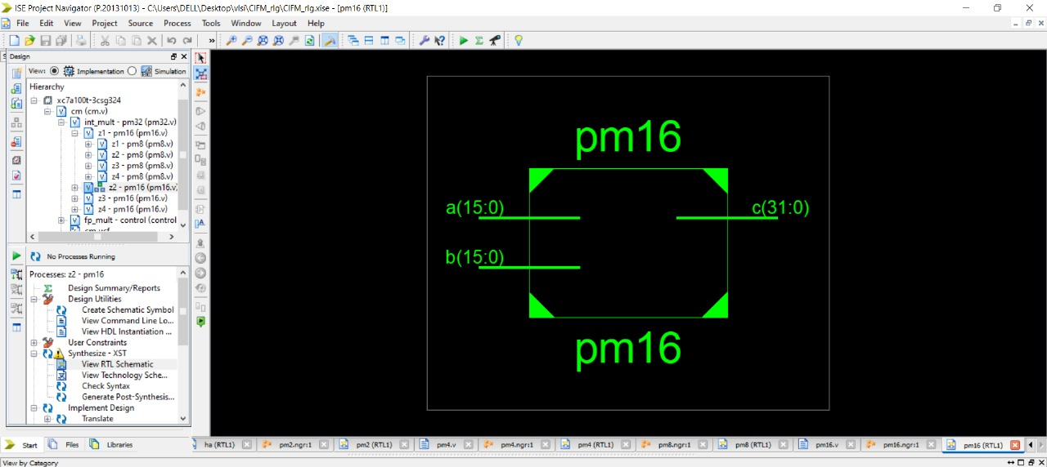
16 bit Multiplier using 8-bit Multiplier :
Batch No. 10 25

Slide 27
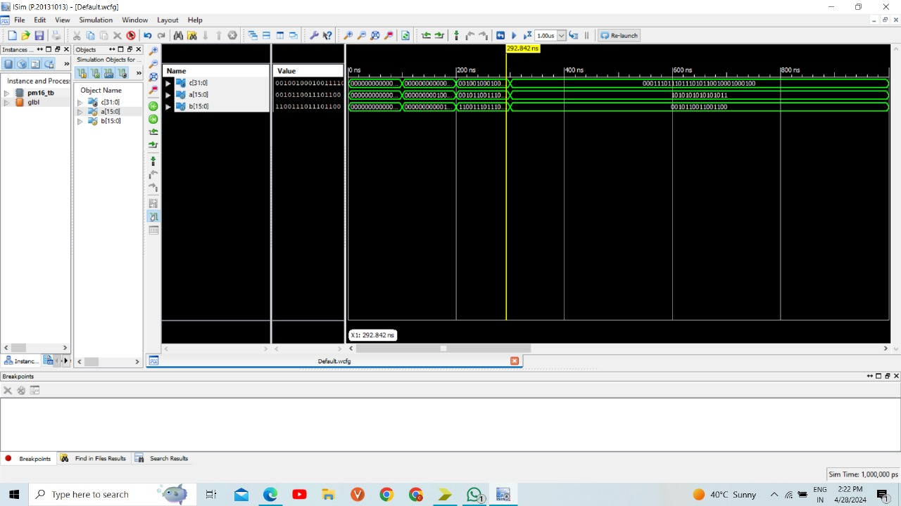
Waveform of 16 bit Multiplier:

Slide 28
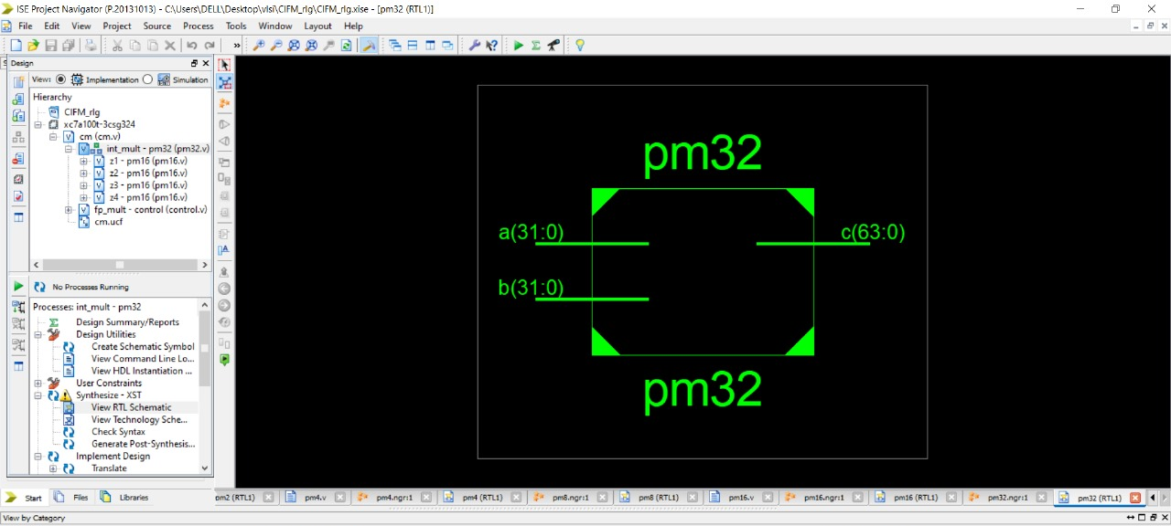
32 bit Multiplier using 16-bit Multiplier:

Slide 29

RTL Schematic of 32-bit Multiplier:
Batch No. 10 28

Slide 30
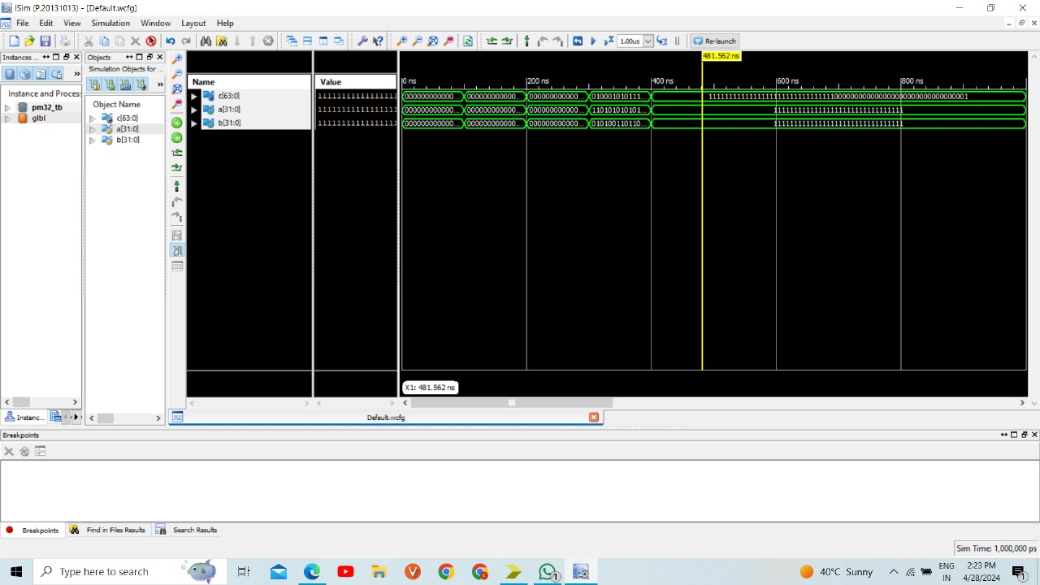
Output waveform of 32-bit Multiplier:
Batch No. 10 29

Slide 31
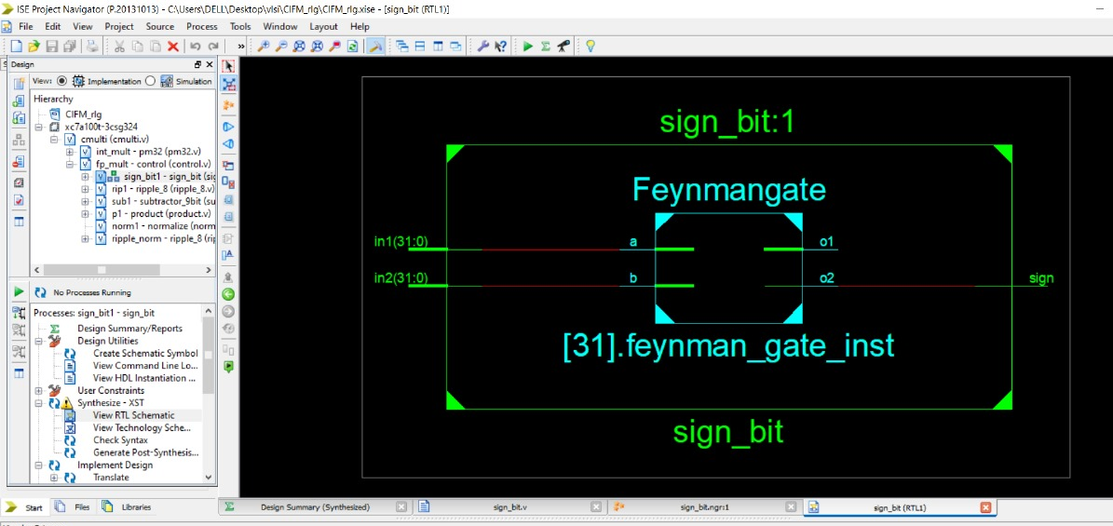
FLOATING POINT MULTIPLIER:
1.Sign Bit:
Batch No. 10 30

Slide 32
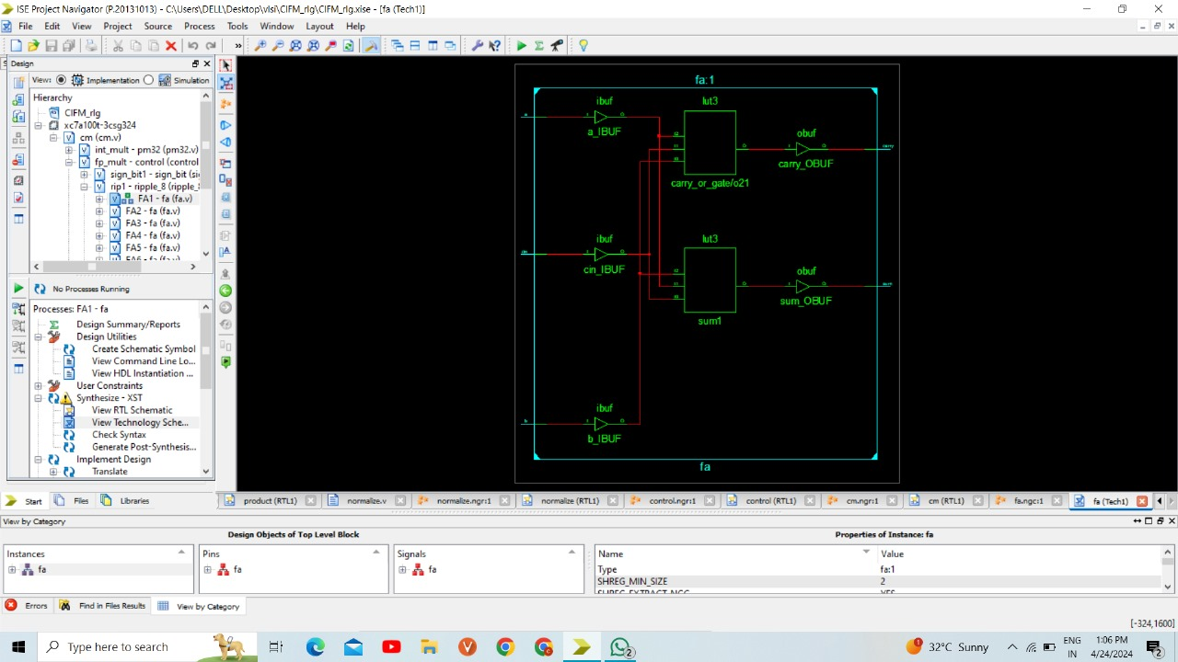
2.Adding Exponents:
Full adder using half adder:
Batch No. 10 32

Slide 33
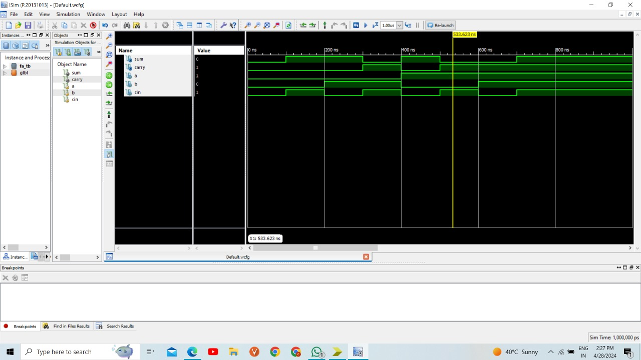
Waveform of Full adder using half adder:
Batch No. 10 33

Slide 34
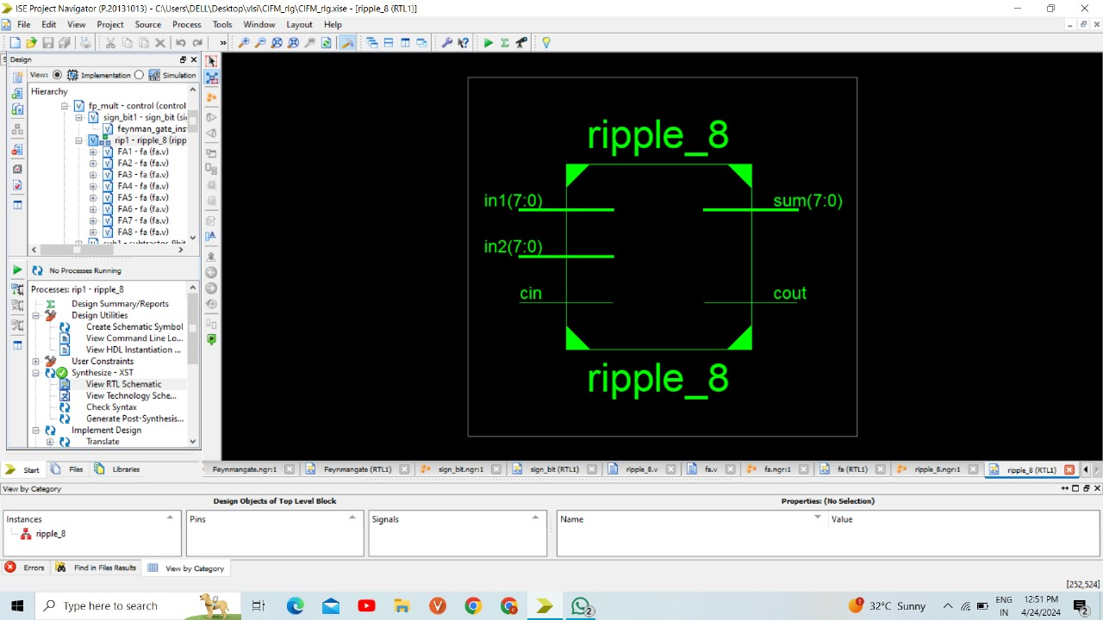
8bit Ripple Carry Adder:
Batch No. 10 34

Slide 35
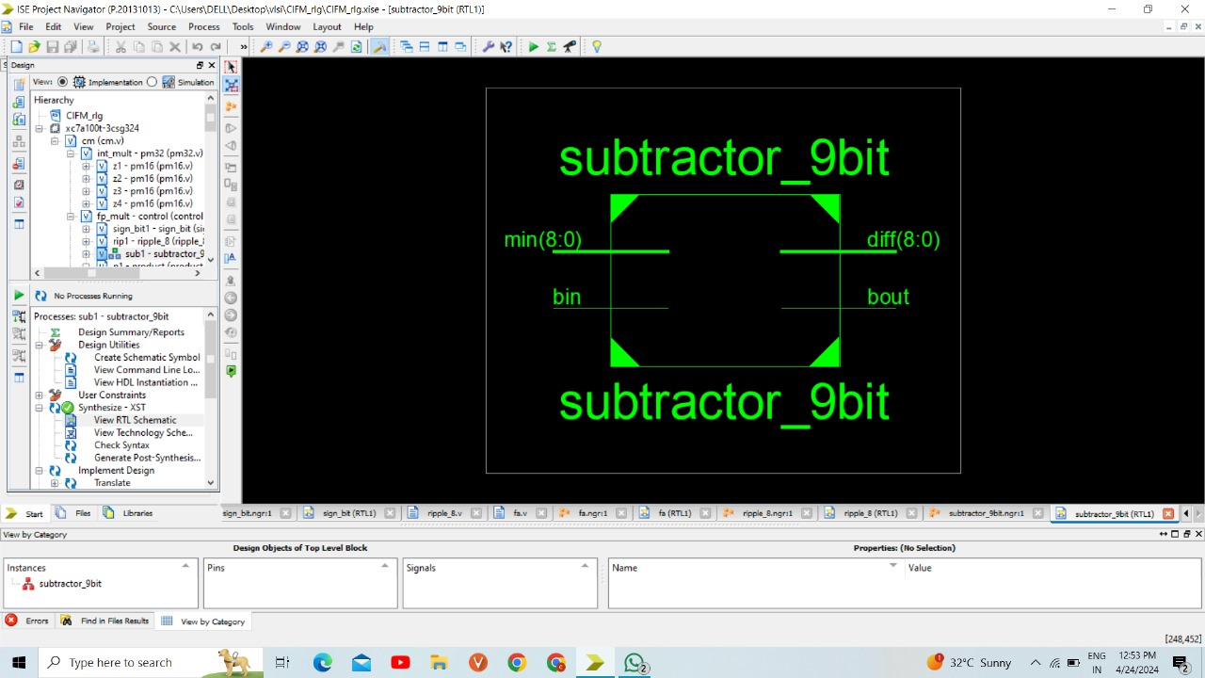
3.Subtracting the Bias:
Batch No. 10 36

Slide 36
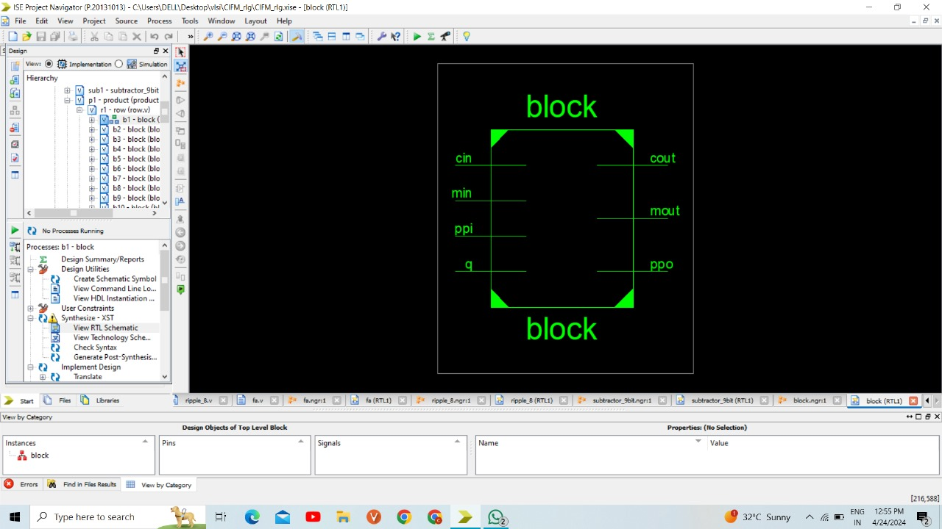
4.Multiplying the Mantissa:
(a) Block:
Batch No. 10 37

Slide 37
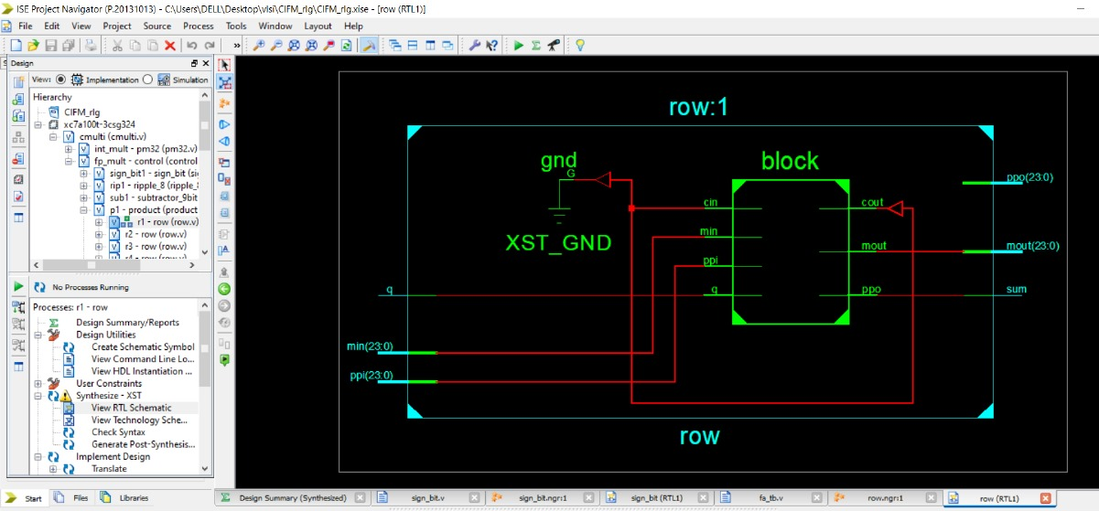
Row level Multiplication :
Batch No. 10 38

Slide 38
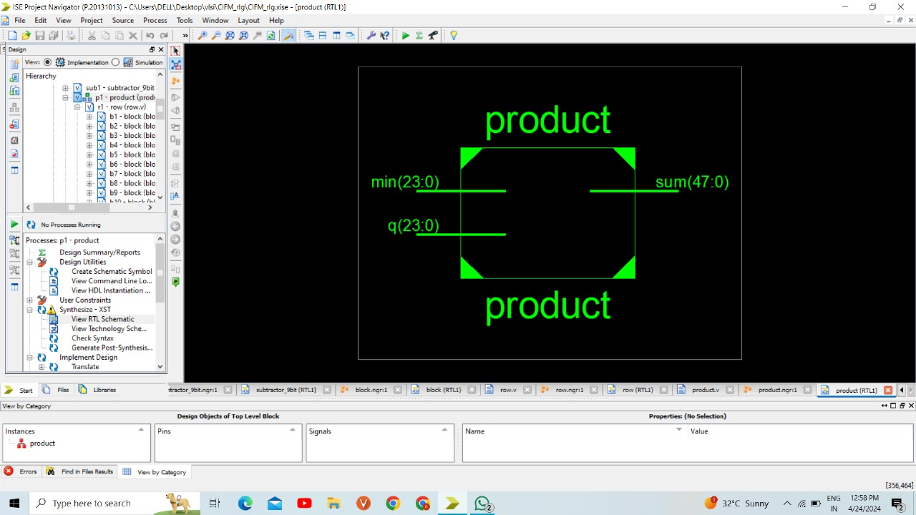
Product:
Batch No. 10 39

Slide 39
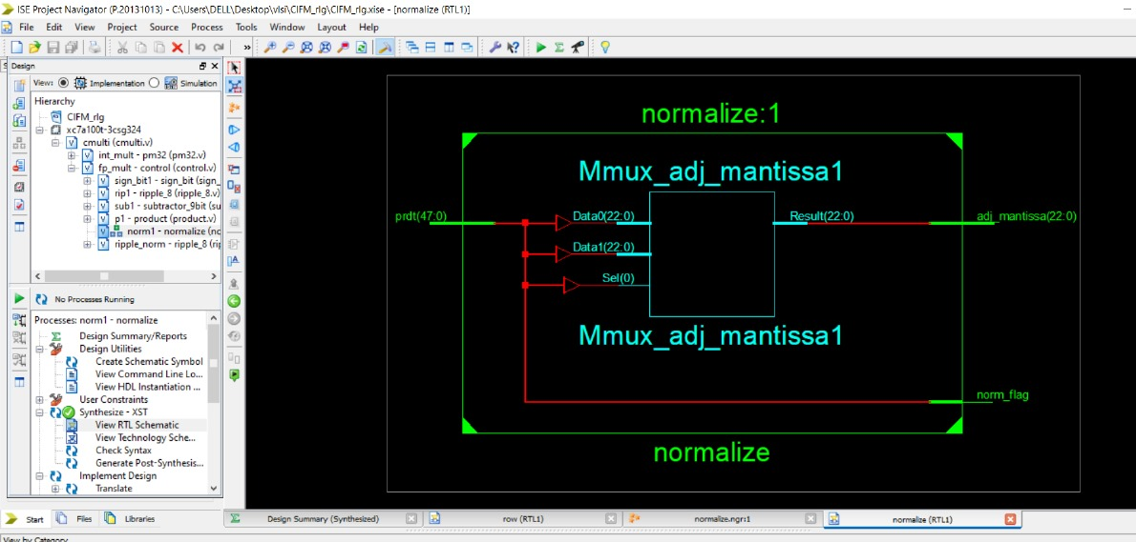
5.Placing the binary point and normalizing the mantissa:
Batch No. 10 40

Slide 40
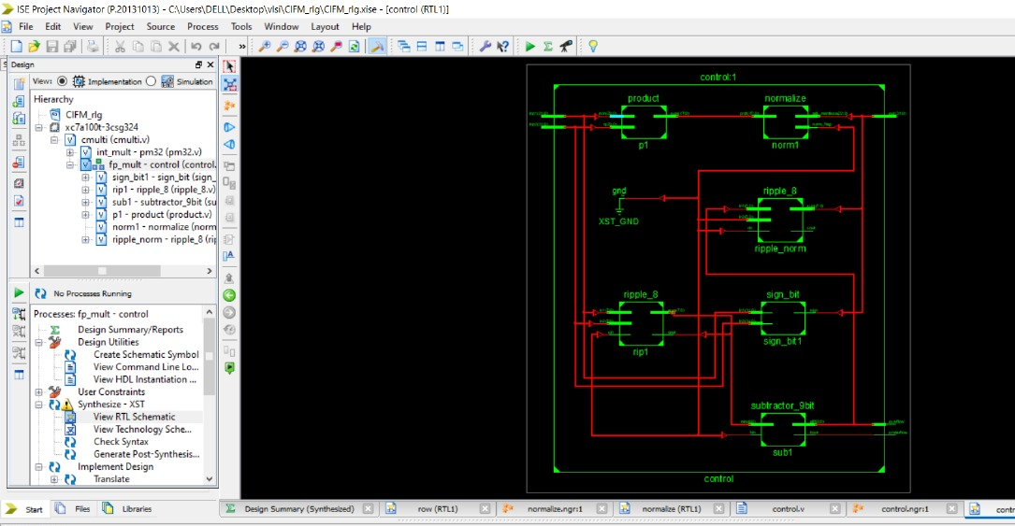
6.Floating point multiplier:
Batch No. 10 41

Slide 41
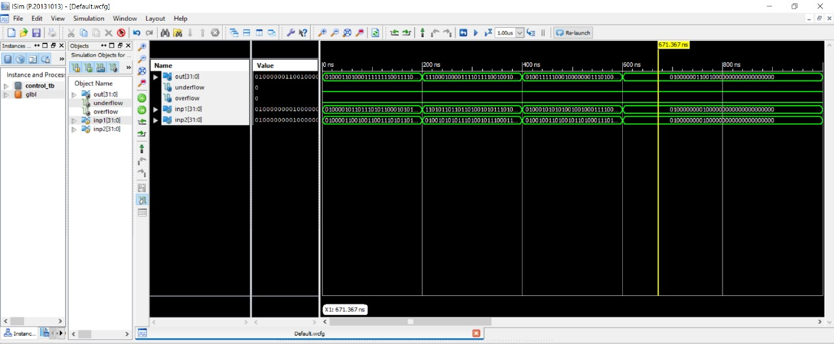
Output waveform of Floating point multiplier:
Batch No. 10 42

Slide 42
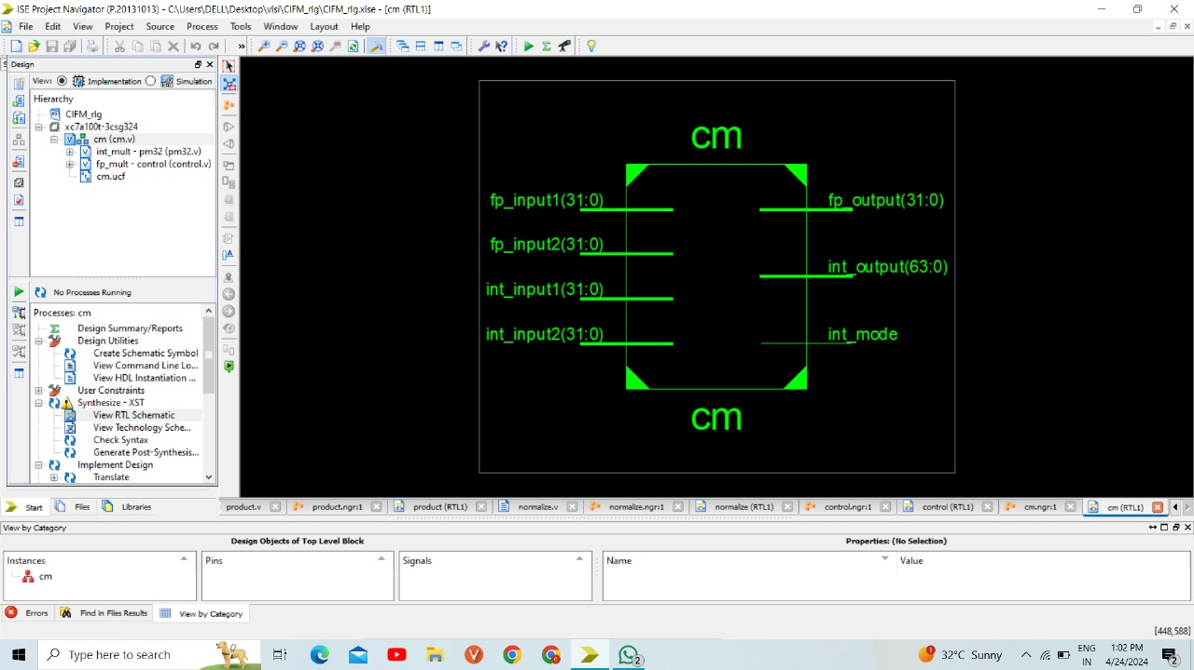
32bit Combined integer and Floating Point Multiplier :
A 32-bit combined integer and floating-point multiplier is designed to perform multiplication operations on both integer and floating-point numbers within a 32-bit architecture. These kinds of multipliers are commonly found in digital signal processing (DSP) applications, scientific computing, and other areas where both integer and floating-point arithmetic are required within the constraints of a 32-bit architecture.
RTL Schematic of 32 bit Multiplier
Batch No. 10 43

Slide 43
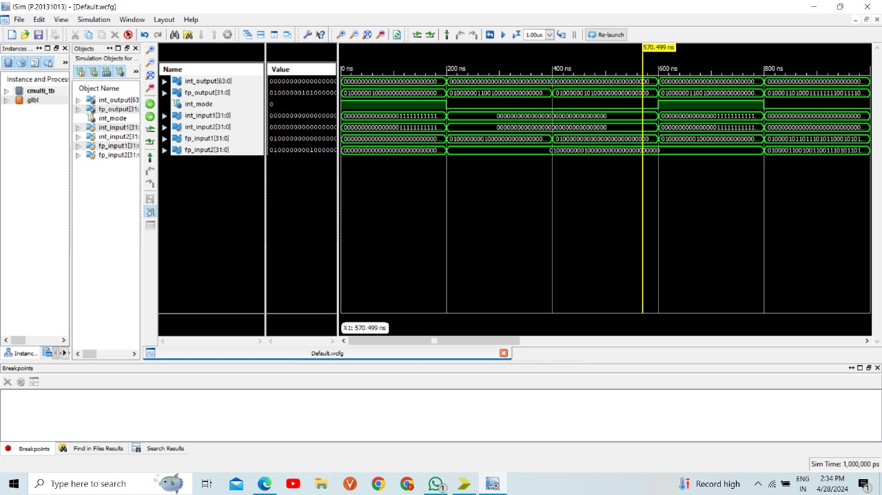
Output Waveform of Combined Integer and Floating point Multiplier
Batch No. 10 44

Slide 44
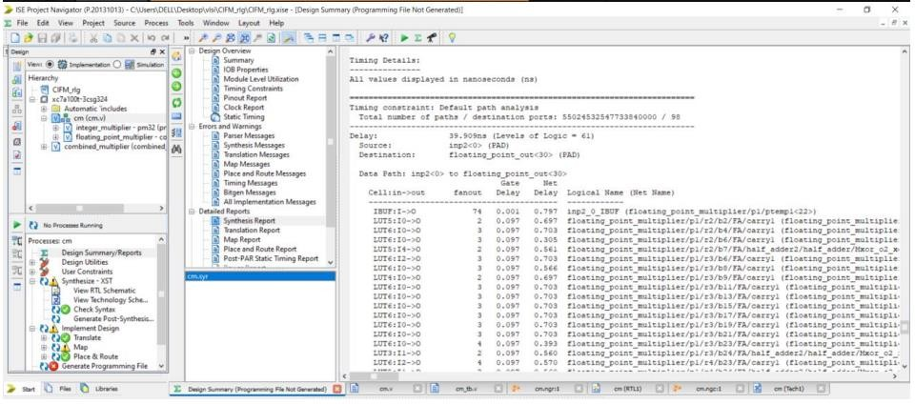
Delay obtained for Combined Integer and Floating Point Multiplier
Batch No. 10 45

Slide 45
Delay Comparison Table :
Reversible Gates
Logic Gates
CIRCUITS | DELAY
Logic gates | 9.23ns
Full Adder | 9.033ns
2bit Multiplier | 9.073ns
4bit Multiplier | 21.531ns
8bit Multiplier | 27.6962ns
16bit Multiplier | 36.789ns
32bit Multiplier | 46.507
CIRCUITS | DELAY
Peres Gate | 0.889ns
Feynman Gate | 0.733ns
TS Gate | 0.943ns
Full Adder using Peres gate | 0.949ns
2bit Multiplier | 0.948ns
4bit Multiplier | 3.496ns
8bit Multiplier | 6.645ns
16bit Multiplier | 9.680ns
32bit Multiplier | 13.332ns
Floating Point Multiplier | 40.390ns
Combined integer and floating point multiplier | 39.909ns
Batch No. 10 47

Slide 46
Comparison of Performance Characteristics
Name of multiplier | Vendor | Delay(nSec)
Proposed4bit Reversible Vedic multiplier(Reference paper 1-4244-0173) | Xilinx | 5.353ns
4bit Multiplier using Reversible logic | Xilinx | 3.496ns
32bit Combined integer and Floating Point Multiplier | Xilinx | 39.909ns

Slide 47
Applications:
Quantum Computing: Reversible logic is fundamental to quantum computing, where operations must be reversible to maintain coherence and avoid energy loss. Our multiplier could serve as a key component in quantum circuits for arithmetic operations, enabling more efficient quantum algorithms for tasks such as factoring large numbers and simulating quantum systems.
Low-Power Computing: Reversible logic gates have the potential to reduce energy consumption in conventional computing systems. By incorporating our multiplier into low-power devices such as smartphones, wearables, and IoT sensors, we can extend battery life and reduce environmental impact without sacrificing computational performance.
Digital Communication Systems: Digital communication systems, including wireless communication, data transmission, and networking, rely on efficient signal processing algorithms for encoding, decoding, and error correction. Multipliers using Reversible logic can accelerate these algorithms by efficiently processing integer and floating-point operations, leading to improved data throughput and reliability.
Batch No. 10 49

Slide 48
CONCLUSION :
In conclusion, this project effectively addressed the complex task of designing a 32-bit reversible combined integer and floating-point multiplier. Through systematic development, a foundation was laid using fundamental reversible logic gates such as Peres and Feynman Gates. Starting from basic components like half adders and full adders and progressing to higher-level multipliers, a robust integer multiplier capable of handling 32-bit operands was constructed. Transitioning to floating-point arithmetic, components were devised to manage the intricacies of floating-point representation, including sign bit calculation, mantissa calculation using a 24x24 bit multiplier, and exponent calculation employing ripple carry adders. These components were seamlessly integrated to form a comprehensive floating-point multiplier capable of accurately processing floating-point inputs while preserving precision and range. The integration of both integer and floating-point multiplication functionalities ensures versatility and efficiency in handling various input scenarios. The system adeptly produces integer output when dealing with integer inputs, floating-point output when both inputs are floating-point numbers, and correctly computes floating-point output when one input is an integer and the other is a floating-point number.
Overall, the project demonstrates a meticulous fusion of theoretical concepts and their practical application in designing an advanced and adaptable multiplier. This multiplier adeptly meets the demands of modern computational challenges, showcasing its adaptability and effectiveness.
Batch No. 10 50

Slide 49
Future Scope:
This work can be extended by exploring the integration of additional arithmetic operations beyond multiplication, such as division, square root, and exponentiation, into the existing multiplier architecture. This expansion would create a more comprehensive arithmetic processing unit capable of handling a wider range of computational tasks within digital signal processing systems.
Furthermore, enhancing the versatility and adaptability of the multiplier unit by incorporating configurable parameters and modes of operation could significantly broaden its applicability across diverse application domains. For instance, implementing configurable precision settings for floating-point operations or supporting various integer arithmetic formats would enable the multiplier to cater to a broader spectrum of computational requirements.

Slide 50
References:
[1] Pandimeena R, Annapoorani A, Kaviya T.D, Rajalakshimi A and Dhanagopal R,” Design and Comparison of Power, Area and Delay of 32-bit Reversible MAC unit”, in IEEE , on Advanced Computing & Communication Systems (ICACCS) , May 10,2020.
[2] Syed Farah Naz and Ambika Prasad Shah ,” Reversible Gates: A Paradigm Shift in Computing”, in IEEE Open Journal Of Circuits And Systems , 15 August 2023 ,vol. 4, pp.241 257.
[3] Anekant Jain and Rakhee Jain ,” Design of Reversible Single Precision and Double Precision Floating Point Multipliers”, in IEEE open journal Of Circuits , RGPV, Bhopal ,India 2018 .
[4] Mr. Ashish K. Thakre , Prof. Sujata S. Chiwande and Mr. Sumit D. Chafale ,” Design of Low Power Multiplier Using Reversible Logic Gate”, in IEEE Journal , Nagpur, India 2014.
[5] Anamika and Rockey Bhardwaj, “ Reversible Logic Gates and its Performances “,in IEEE journal , Chandigarh University Gharuan, India 2018.
Batch No. 10 52

Slide 51
THANK YOU & Queries….?

